Slide 1
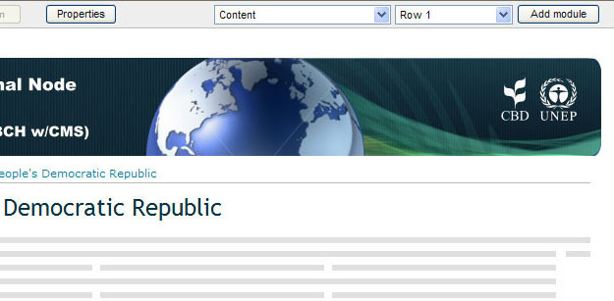

4.3 Adding Modules to a Page
Modules can be added to a page by clicking on the “Add Module” button on the right portion of the design bar.
CLICK HERE

Slide 2
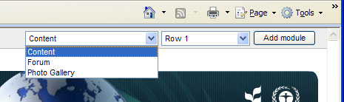
4.3 Adding Modules to a Page
But before using this button, first you must set the following:
Type of module. Three types of modules that can be added: Content, Forum and Photo Gallery.
SELECT HERE

Slide 3
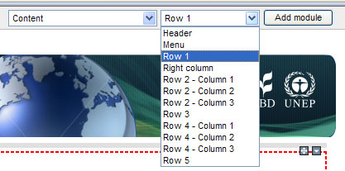
4.3 Adding Modules to a Page
But before using this button, first you must set the following:
The position on the Web Content Area where the module will appear. There are 12 choices.
SELECT HERE

Slide 4
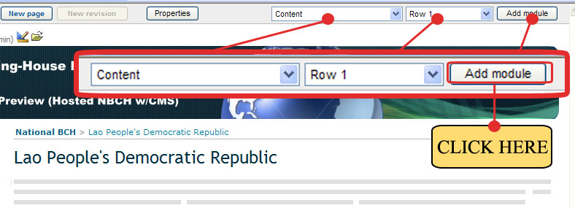
4.3 Adding Modules to a Page
Example. Adding content to the new page - Lao People’s Democratic Republic.
Step 1. Set the following: Module type to CONTENT, Position to ROW 1.
Step 2. Click Add Module button.

Slide 5
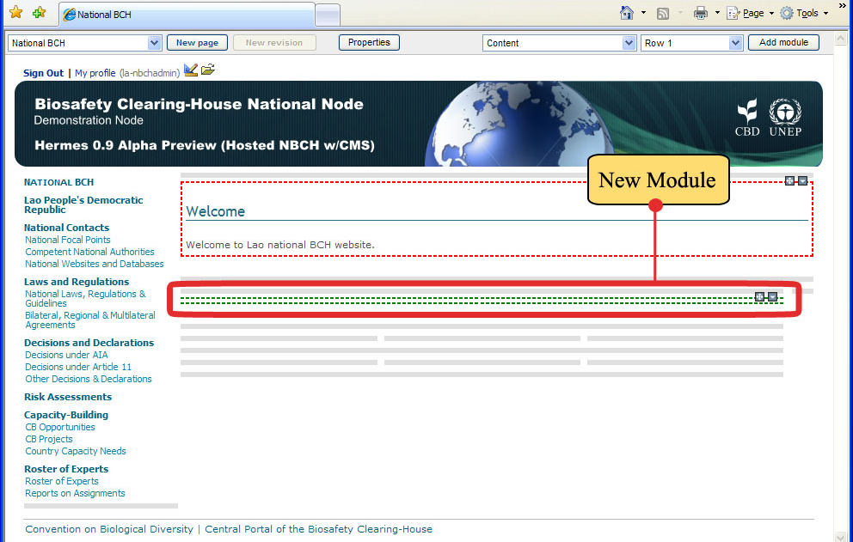
4.3 Adding Modules to a Page
A new module is now created. Highlighted by green dotted lines and contains two new symbols at the rightmost area of the module ( ).

Slide 6
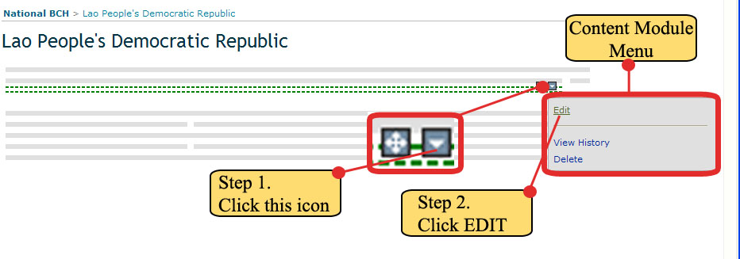
4.3 Adding Modules to a Page
Step 3. To insert data, click on the icon. After clicking, a new window called the Content Module menu will appear, then click EDIT

Slide 7
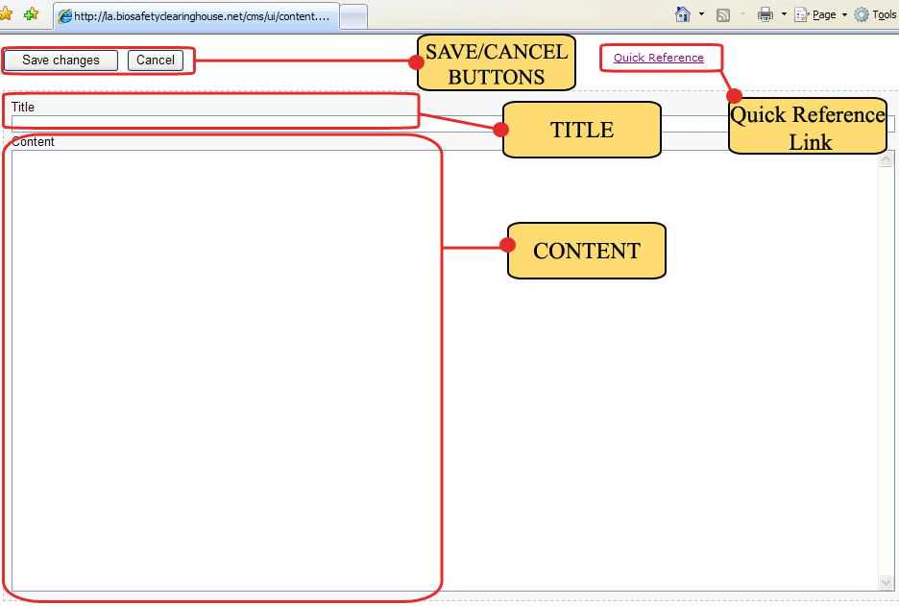
4.3 Adding Modules to a Page
After this action, the Content Editor page will appear where the following must be set: Title of the module and the content. Shown are parts of the Editor page.

Slide 8
4.3 Adding Modules to a Page
Before proceeding to the example, it is important to note an essential part of this page, the Quick reference Link.
This will direct the administrator to the CMS Quick Reference page where the basic content syntax of this CMS can be found.
It’s a must for every administrator to take a look to this page.

